Slide 1

CAR RENTAL SYSTEM
Team Software Process
Group-7
Under the guidance of
Mehfooza Munavar Basha

Slide 2
TEAM MEMBERS
Koduri Gokul (19bcd7006) -Team lead/Planning manager
Mohan Kurmala (19bce7550)-Process manager
Mohamed Habeeb (19bce7583)-Support manager
Vivek Patric (19bce7579)-Development manager

Slide 3
Introduction
The purpose of this project is to provide a platform between customers and a Car Rental organisation. So that, Customers can book a car from the website itself and receive it on that particular day.
This document is used by developers for understanding the requirements of the project; also the intended users of this document are project managers for planning and scheduling, testers to generate test cases, document writers for preparation of user manual and for other end-users/stakeholders to validate their requirements.

Slide 4
Cycle-1
S.NO | Date | Title Meeting
1 | 05/02/2022 | Establish product and business goals
2 | 12/02/2022 | Assign roles and define team goals
3 | 19/02/2022 | Produce development strategy and process
4 | 26/02/2022 | Build overall and near-term plans
5 | 05/03/2022 | Develop the quality plan
6 | 12/03/2022 | Build individual and consolidated plans
7 | 19/03/2022 | Conduct risk assessment
8 | 24/03/2022 | Prepare management briefing and launch report
9 | 02/04/2022 | Hold management review
W E E K - 1
W E E K - 2

Slide 5
Cycle-2
MEETINGS
Week-1
Week-2
S.NO | Date | Title Meeting
1 | 09/04/2022 | Risk Management
2 | 16/04/2022 | Correction connection
3 | 23/04/2022 | Project Overview
4 | 30/04/2022 | Final Report

Slide 6
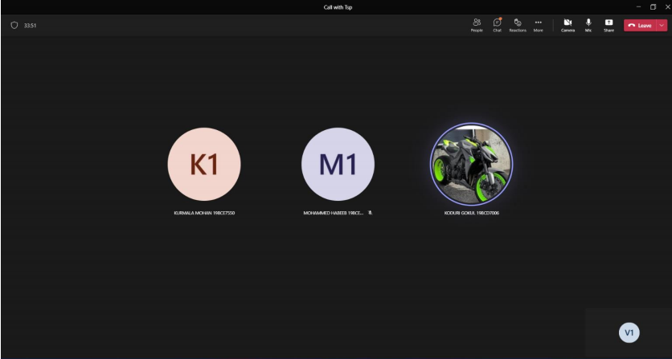

Slide 7
TEAM LEADER
Manage the operation innovations .
Guides software development teams through coaching sessions.
Able to effectively provide reasonable estimates for project timelines.
Manage teams to maintain a high quality for products.

Slide 8
PLANNING MANAGER
Planning and organized all meetings.
Tracked the team’s progress.
Maintain the work flow.
Plan the work balanced team progress plan.
Track the team’s workload plan status.
produced the task plan report team status.

Slide 9
QUALITY / PROCESS MANAGER
Tasks Undertaken -
As a quality process manager:
I'm responsible for the implementing and executing inspection, testing and evaluation methods to ensure that products adhere closely to company standards.

Slide 10
QUALITY / PROCESS MANAGER
And also I've done some tasks as per my role:
Developed a quality plan with high standards for the project.
Improve reliability of new product development processes.
Maintain company quality standards.
Review products, processes and systems on an ongoing basis to determine where improvements can be made.
Oversee the product manufacturing process to ensure quality.
Actively participate in production meetings with the manufacturing team

Slide 11
QUALITY / PROCESS MANAGER
Project Contribution:
As a Quality manager, I've summarized every meeting Planning for a proper documentation.
Me and Planning manager worked together on scheduling meetings smoothly with prior information to all team members.
Developed Quality metrics for each and every module of the project to the company standards.
Reviewed the project modules,processes and system on an ongoing basis to check whether any change or improvements can be made
.

Slide 12
SUPPORT MANAGER
Tasks Undertaken:
• Conducted risk assessments and recommended changes for risks were made.
• Made sure that the team has suitable tools to carry on the work
Roles and Responsibilities :
• Maintained the team's risks and issues tracking and reported each week.
• Acts as the team's reuse advocate.
• Handle the team's issue and risk-tracking.

Slide 13
SUPPORT MANAGER
Project Contribution :
• Worked as project developer
• Participated in producing the development cycle report.
• Produced configuration management plan.
Tracked reuse and new reuse and report progress and status in the weekly team
meetings.

Slide 14
DEVELOPMENT MANAGER
TASKS UNDERTAKEN
Planned the development strategy for each work modules
Assigned the daily tasks and weekly launch meetings
Interacting with the team members frequently and sorting the issues with in 1-2 days
Explaining the final goal of the project and dividing the work for cycle 1 and cycle 2

Slide 15
DEVELOPMENT MANAGER
Project Contribution
Developed partial backend and frontend of our project.
Developing the existing modules.
Performed Testing.
Starting the Launch scripts.

Slide 16
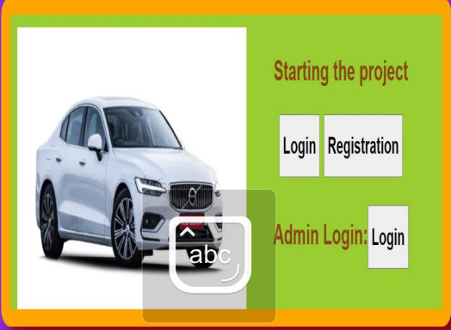
PROJECT SCREENSHOT

Slide 17
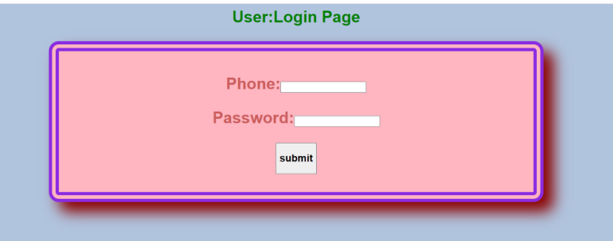
PROJECT SCREENSHOT

Slide 18
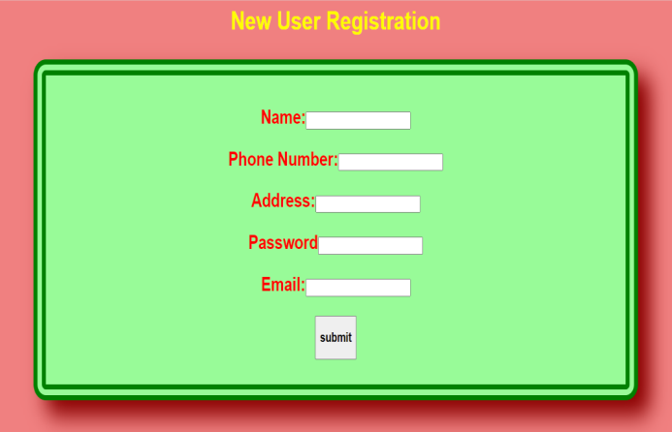
PROJECT SCREENSHOTS

Slide 19
CONCLUSION
CAR RENTAL SYSTEM is a web based system for a company that rents out cars. This system enables the company to make their services available to the public through the internet and also keep records about their services. The world has become a place where there is a lot of technological development; where every single thing done physically has been transformed into computerized form. Car renting is essential to many peoples’ plan to travel or move from one place to another for business purposes, tour, and visit or holidays, for these reasons Car renting is very helpful.Car renting became more popular as years passed by. Today Car renting services are found all over the world, especially in the developed and developing countries. To make this service more popular and accessible to the public it has been transformed into a web base system and connected to the internet where everyone can be able to have access to it.
The system manages the most important components of a car rental company through a modular network, which can be adapted to any country or size.It connects management of a fleet, people, and business, to make the operations as efficient as possible. Alongside the basic rental of a vehicle, car rental agencies typically also offer extra products such as insurance, global positioning system (GPS) navigation systems, entertainment systems, mobile phones, portable WiFi and child safety seats.

Slide 20



